Slide 1
Introduction to Python and Data Science
Yaroslav Shtogun

Slide 2
Agenda
Introduction
Python History
Python Development Environments
Reference Book

Slide 3
Why Python?
Personal Experience (background C++, C#)
Readable and Maintainable Code (emphasizes on code readability)
Multiple Programing Paradigms (functional and object-oriented programing )
Compatible with Major Platforms and Systems
Robust Standard Library (many libraries to help with programming)
Many Open Source Framework and Tools (web application development - Django, Flask, Pyramid; ML/AI – Pytorch, TensorFlow, Keras)
Simplify Complex Software Development (ML and AI development)
Adopt Test Driven Development (easy way to create prototypes)

Slide 4
Python history
The python language was develop by Guido van Rossum at Centrum Wiskunde & informatica in the Netherland in December 1989
February 1991 – Python 1
October 2000 – Python 2
December 2008 – Python 3 (major backwards-incompatible release)
The latest release – Python 3.9
The most stable – Python 3.7

Slide 5
Python development environments
Anaconda is open-source distribution platform for Python and R programing languages.
Spyder (more like R-Studio)
PyCharm (similar to Spyder and R-Studio)
Jupyter Notebook - open-source web application that allows you to create and share documents that contain live code, equations, visualizations and narrative text
Google Colab – free-cloud based Jupyter Notebook

Slide 6
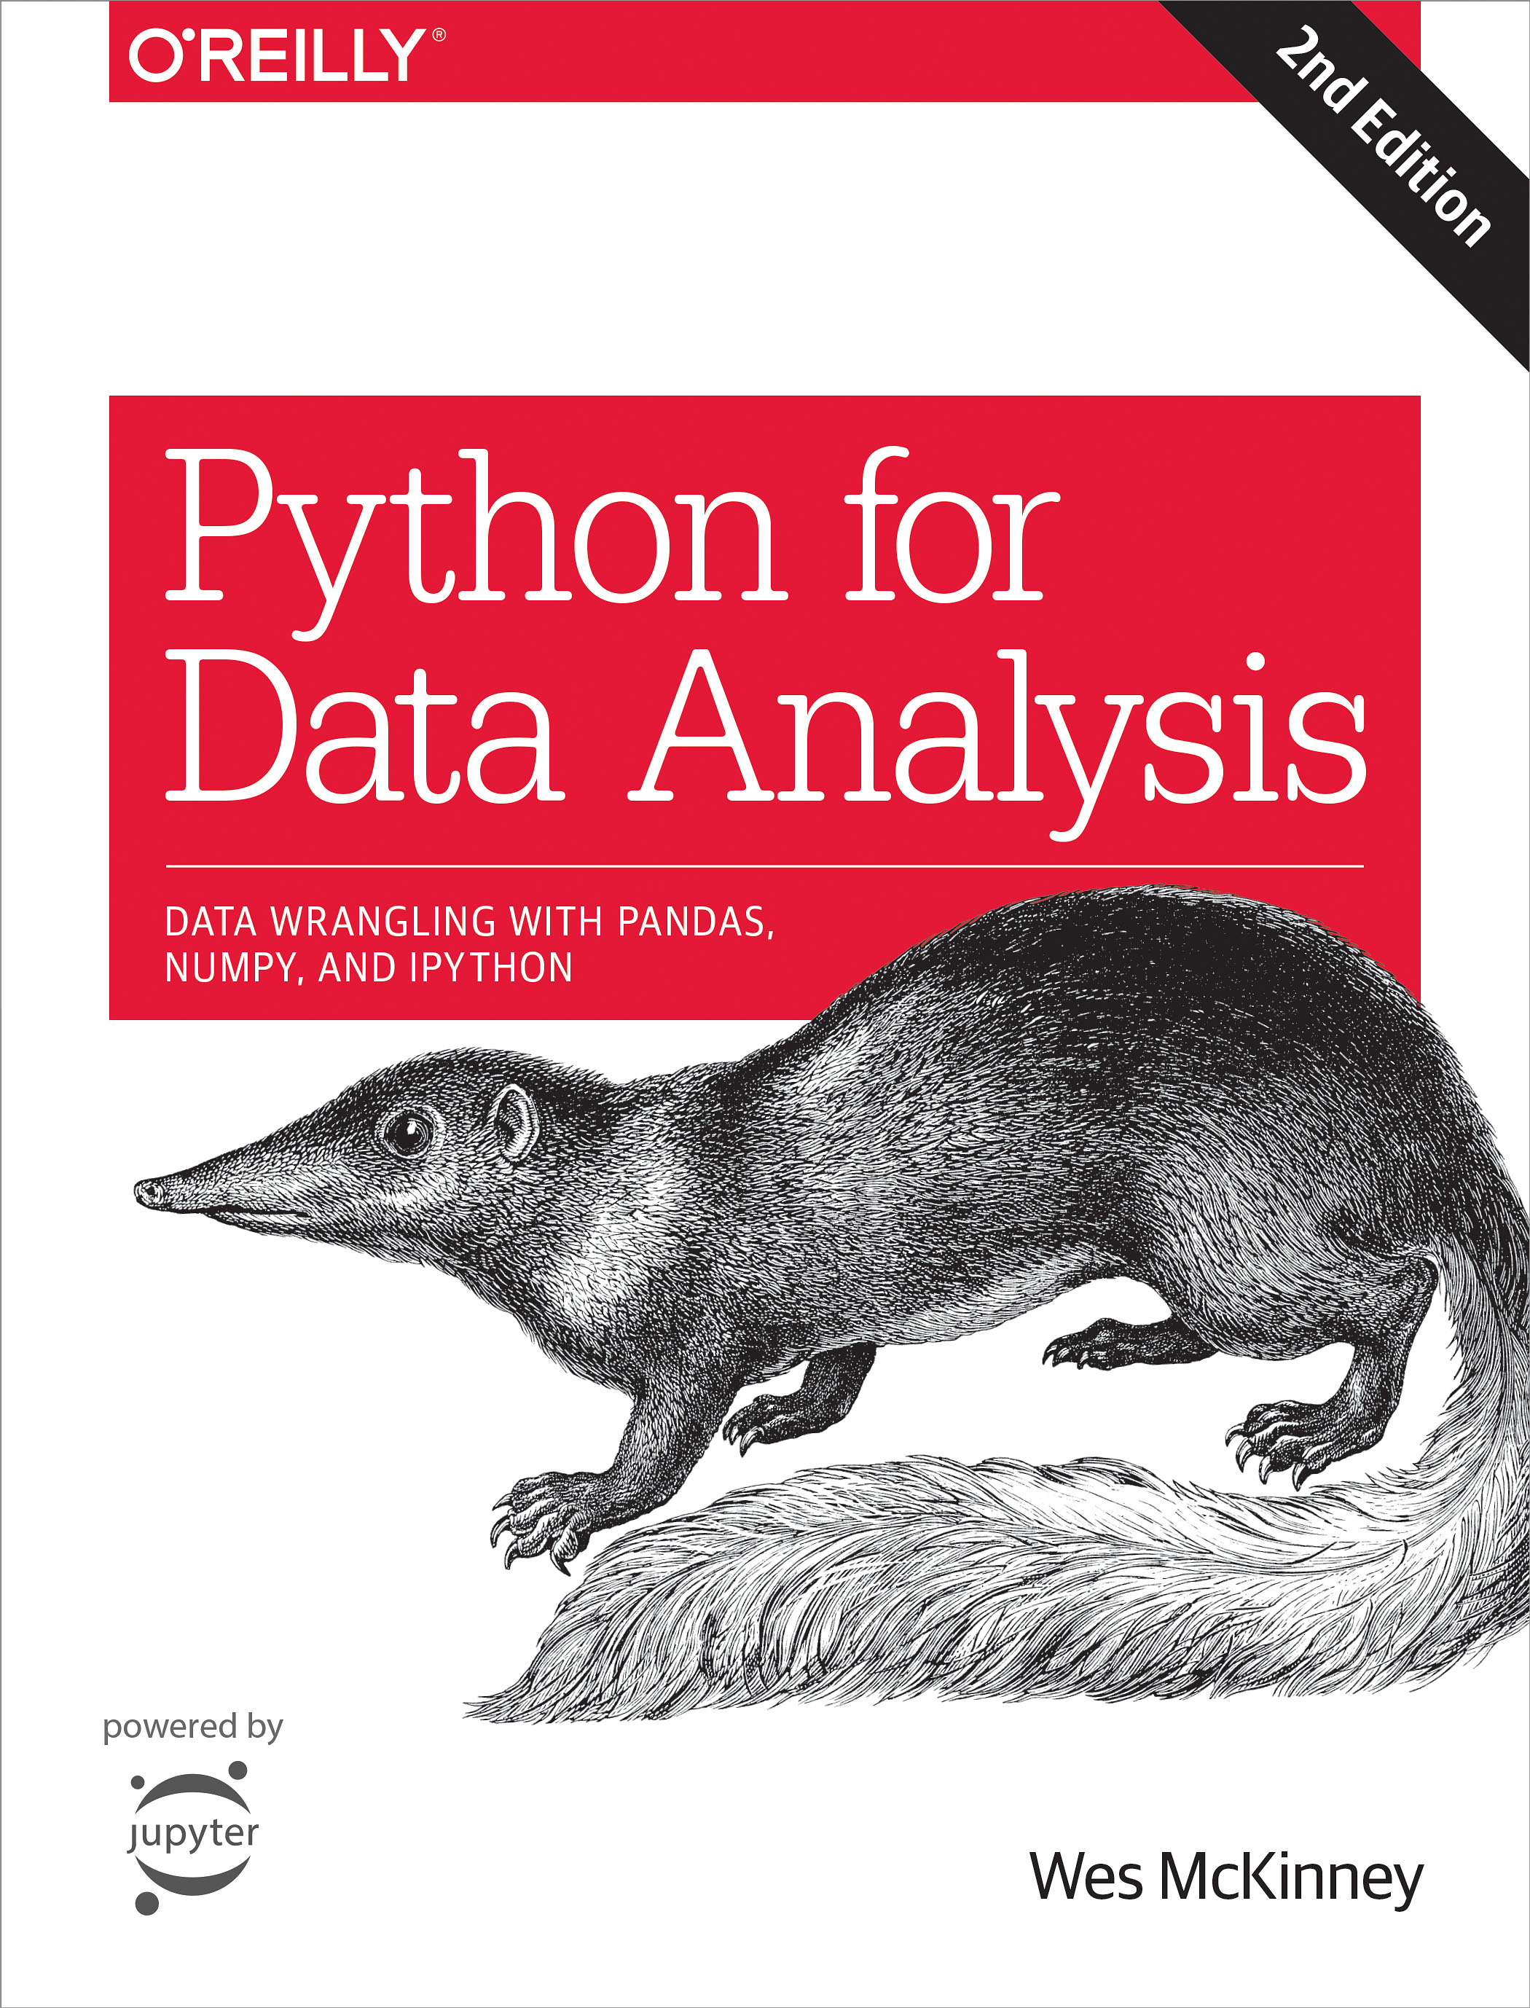
Book

Slide 7
Next Step
Python Data Types
Exploring Jupyter Notebook functionality
Get some practice

